Slide 1
. You must use slides. File format is up to you (e.g. ppt, pdf, etc)
. You must submit your slides on Owlspace (this assignment) before the class begins
. Use 5 minutes to motivate the problem/question that you want to address
. Use 2 minutes to summarize relevant related work
. Use 8 minutes to outline your new solution or approach to addressing the problem/question
. Use 8 minutes to describe your progress/findings so far
. Use 2 minutes to describe your remaining work
. 5 minutes of Q&A will follow your presentation

Slide 2
DIAS: Decentralizing the Internet Application and Service
Midterm Presentation
3/13/14
Adriana Flores
Clayton Shepard
Ellis Giles
Haiuhua Shen
Yanda Lu

Slide 3
Agenda
Background & Motivation
Related Work
DIAS Overview
Progress
Demo
Remaining Work

Slide 4
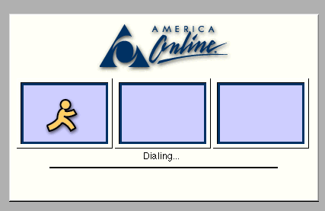
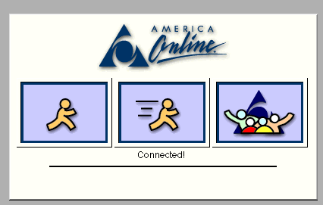

Motivation - Before
Rare users have persistent always-on connections.
Instead, servers were always connected to the internet
Intermediary for communication

Slide 5
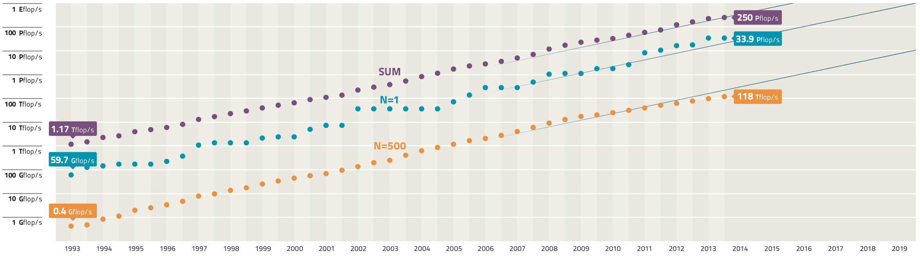
Motivation - Today
52Gflop/s
Mobile devices:
Widely adopted
Always-on
Always connected
Powerful Mobile Devices
Galaxy S4 - as powerful as a year 2000 super computer
Why do we still rely on servers?
Notes:
-Today’s phones e.g. galaxy s4 51 G flops = super computer in 2000
Why do we still rely on servers the internet
Increase in # devices
Wireless network more and more available.
Smart phone widely adopted with wireless data.

Slide 6
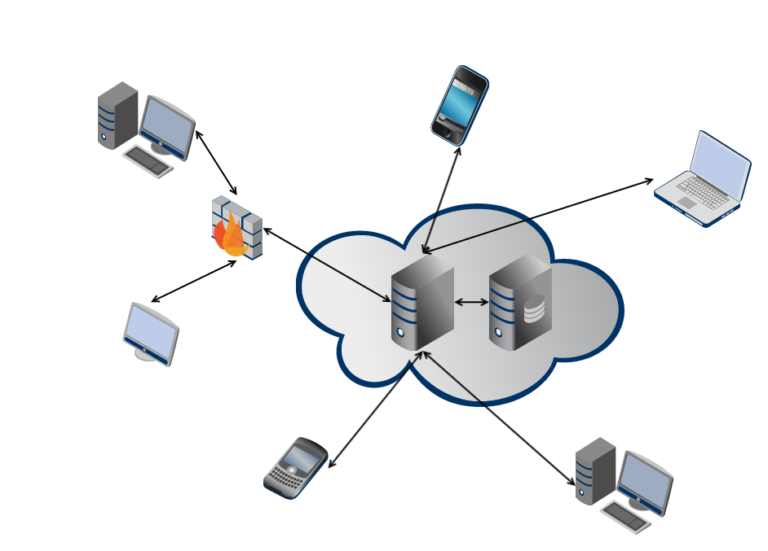
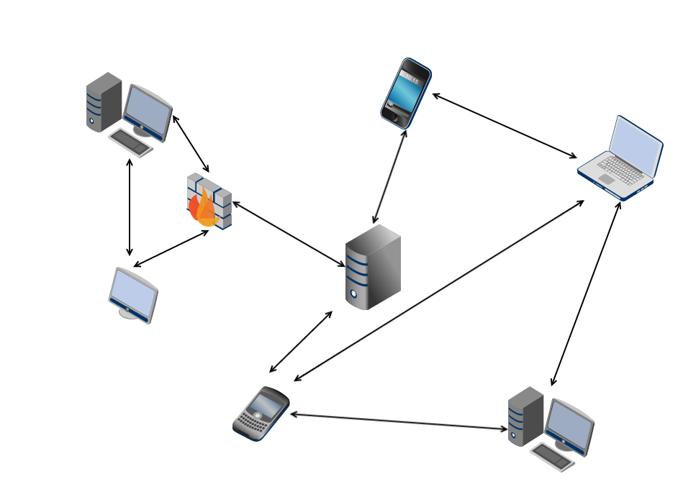
DIAS: Decentralizing the Internet Application and Service
Centralized Architecture
Single point of failure
☒ Privacy
☒ Security
☒ Energy efficiency
Decentralized Architecture
Robust to failure
Reclaim personal data
Power efficieny
Notes:
centralized servers have many drawbacks, ranging from
privacy, security, and fault-tolerance, to even energy-efficiency
and control over data
Decentralize the current server-client mode paradigm in the current Internet

Slide 7
DIAS Overview – Join w 8
Decentralized internet architecture in which servers are replaced with point to point communication for personal communication and services.
Benefits:
Security, privacy, resilience, cost, and power
Challenges:
Redundancy
Uptime
Data
Notes:
no technological reason that devices can’t connect directly to one another
We need to find novel methods to ensure redundancy for both uptime and data.
How do we ensure reachability?
What happens if the cellphone loses connectivity?
What if it is lost/broken/stolen?

Slide 8
DIAS
Goal:
Decentralize the current server-client mode paradigm in the current Internet.
Benefits:
Privacy.
Security.
Resilience.
Energy.
Connectivity:
Use our phones as personal servers.
With IPv6 (which includes mobile IP), no device will lose connection.

Slide 9
Mission - Vision
Build a first generation decentralized architecture which supports typical personal communication and applications including:
Email
Web Pages
Social Networking
Chat

Slide 10
Related Work
Decentralized internet
Data replication
Connectivity
Peer to peer

Slide 11
Related Work - Decentralized Internet
Distributed online social network
Facebook => Persona
Twitter => Cuckoo
BitCloud
BitCoin

Slide 12
Related Work – Peer to peer
Peer to peer
Chord - MIT
Pastry
Etc.

Slide 13
Related Work – Data Replication
Data replication
CFS

Slide 14
Related Work – Connectivity and Reachability
Connectivity and reachability
UIA
IPv6 (Mobile IP)

Slide 15
DIAS Framework
Building Blocks
Integration
Connectivity & Reachability
Devices public accessible
Naming and Domain Management
DNS
Basic Services
Full communication
Email and Web services
Android Application
Key functionality:
Power Management
Data Replication
Failover

Slide 16
Progress
Building Blocks
Integration
Connectivity & Reachability
Devices public accessible
Naming and Domain Management
DNS
Basic Services
Full communication
Email and Web services
Android Application
Key functionality:
Power Management
Data Replication
Failover

Slide 17
Building Blocks

Slide 18
Connectivity and Reachability
Reachability of devices has been previously addressed, but not widely deployed or accessible for deployment.
We utilize a VPN server running at RECG lab server
Allocate static public IPs to our devices
Our devices are publicly accessible
As discussed in
Section II-C, existing work has already addressed, and largely
solved, this issue, thus it will not be our focus. Unfortunately
these methods have not been widely deployed, are blocked, or
have only been tested in lab settings. To bypass this challenge,
we intend to use a VPN server, such as OpenVPN [22],
running on an RECG lab server to allocate static public IPs to
our devices.
devices to be
publicly accessible, as well as provide a reliable way for them
to communicate with each other.

Slide 19
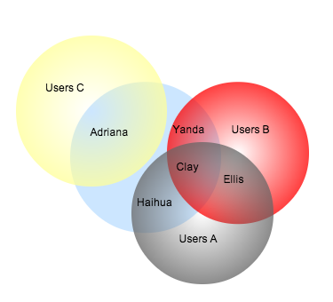
Naming and Management
DNS
Dynamic DNS
Human friendly names
Help with load balancing and failover
Identify our personal clusters
Self-own laptop, smartphone, desktop, tablet, etc.
Clever self failover technique
Establish a failover order self-own devices
Conventional DNS provides human friendly names as well as domain management, and, in
more advanced systems can also provide load-balancing and failover.
In our architecture we will additionally use it help specify our personal ”‘mini-clusters”’ and failover order.

Slide 20
Communication Services
Utilize open-source server software, provide basis for our communication services.
Email Server
Web server
Other services…
Guarantee:
Full communication and service
Backwards compatibility
open-source server software, such as postfix, sendmail, apache,
etc., which will provide the basis of our communication ser-
vices.
full communication
and service, which are even backwards compatible with the
existing email and web services.

Slide 21
Integration

Slide 22
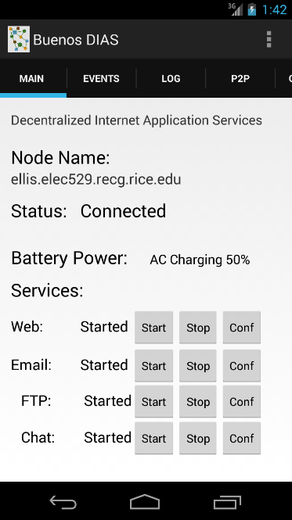
Event and Debug Logs and Configuration Tabs
Configurable Node Name
Connection and Overall Status Monitoring Thread/Event Receiver
Battery Power Monitoring Thread and Event Broadcast Receiver
Can act on power changes.
Pluggable Services List
Services can provide Start, Stop, and Configuration methods.
Web, Email, FTP, etc.

Slide 23
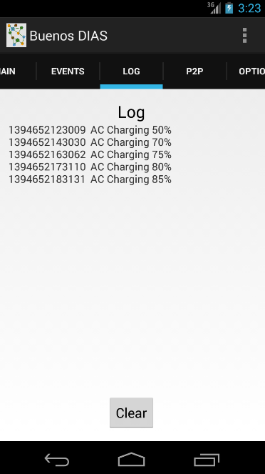

Slide 24
Demo

Slide 25
Links
Picture of
Go to the website

Slide 26
Remaining Work
Develop an app with more functionality
Data replication
Failover handling
Power experiment

Slide 27
Proposed Timeline

Slide 28
References

